Slide 1
Career Skills: Code Space Software Development Week 1
Ryan.Mahoney@edinburghcollege.ac.uk

Slide 2
Introduction
6 Week– Learning Plan
Introductions
Team Skills
What type of learner are you?
SWOT Analysis

Slide 3
Expectations
Every Thursday 2:15pm in this Teams channel.
If you are unable to attend, please contact me via Teams.
Cameras on and engagement from everyone.
Complete tasks outlined during sessions – Time will be built into sessions.
Learn, ask questions and have some fun ☺

Slide 4

Getting to know you…
Name
Dream Holiday
Hobbies
Interesting fact about yourself

Slide 5
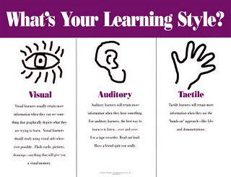
What kind of learner are you?
What type of learner are you?

Slide 6
Getting to know you – Teamwork and it’s importance.
Google – Slido
Enter website and enter pin number that I give you and wait until I begin the poll.
1694443

Slide 7
Good v Bad Experiences
Thinking back to the previous task can you provide any examples where you have experienced good and bad experiences of teamwork?
How did you react/have input to these examples?
Work
School/College
Friends/Family
Hobbies

Slide 8
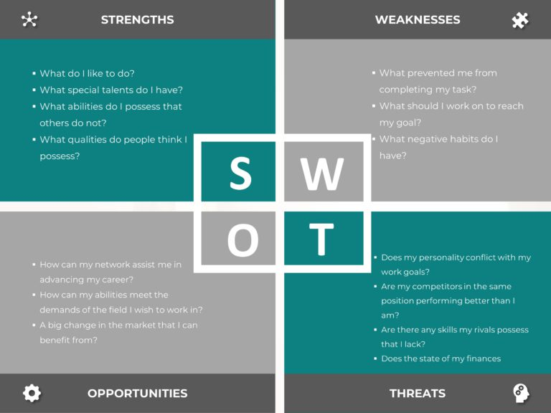
SWOT Analysis
A SWOT analysis for yourself is a valuable self-assessment tool that can lead to enhanced self-awareness, better decision-making, and improved personal and professional development.
Notes:
Self-awareness: Conducting a SWOT analysis encourages self-reflection. You can identify your strengths, weaknesses, opportunities, and threats, leading to a better understanding of yourself. This self-awareness is crucial for personal development and growth.
Goal setting: SWOT analysis can help you set realistic and achievable goals. By identifying your strengths and opportunities, you can leverage them to pursue meaningful objectives. Similarly, recognizing weaknesses and threats enables you to plan and mitigate potential challenges.
Decision-making: When faced with choices or challenges, a SWOT analysis can serve as a decision-making tool. By evaluating the internal and external factors, you can make more informed decisions that align with your strengths and capitalize on opportunities.
Career planning: SWOT analysis can be particularly valuable for career development. It allows you to assess your skills, experience, and aspirations (strengths and opportunities) as well as potential obstacles or areas for improvement (weaknesses and threats). This information can guide your career path and help you make strategic choices.
Personal development: Understanding your strengths and weaknesses provides a foundation for personal development. You can focus on enhancing your strengths and addressing your weaknesses, leading to continuous self-improvement.
Increased confidence: Recognizing and acknowledging your strengths can boost your self-confidence. This positive mindset can be beneficial in various aspects of your life, from personal relationships to professional endeavors.
Risk management: By identifying potential threats and weaknesses, you can proactively manage and mitigate risks. This can be crucial in both personal and professional settings, helping you navigate challenges more effectively.
Time management: Knowing your strengths and weaknesses can assist in effective time management. You can allocate your time and resources more efficiently, focusing on activities that align with your strengths and contribute to your overall goals.
Adaptability: A SWOT analysis encourages adaptability by helping you anticipate and prepare for changes or challenges. Being aware of potential threats allows you to develop strategies for overcoming obstacles and maintaining resilience.
Communication: If you choose to share your SWOT analysis with others, it can serve as a communication tool. Whether in personal relationships or professional settings, it provides a structured way to discuss your strengths, weaknesses, opportunities, and threats with others, fostering better understanding and collaboration.

Slide 9

Task - SWOT analysis
Write your own SWOT analysis.
Your strengths and weaknesses?
Opportunities you have to improve yourself?
Barriers that may get in the way?
How can you overcome them?

Slide 10

Strengths
What advantages do you have that others don't have (for example, skills, certifications, education, or connections)?
What do you do better than anyone else?
What personal resources can you access?
What do other people (and your boss, in particular) see as your strengths?
Notes:
Strengths:
Education and Skills:
Degree in [Your Field] and specialized skills in [Key Skill Areas].
Proficient in [Software/Tools].
[Any certifications or additional training].
Experience:
[X years] of experience in [Your Industry].
Successfully led [specific projects or teams].
Personal Qualities:
Strong work ethic and dedication.
Excellent communication and interpersonal skills.
Ability to work well under pressure.

Slide 11

Strengths
Which of your achievements are you most proud of?
What values do you believe in that others fail to exhibit?
Are you part of a network that no one else is involved in? If so, what connections do you have with influential people?
Notes:
Network:
Well-established professional network.
Mentoring relationships with industry experts.

Slide 12
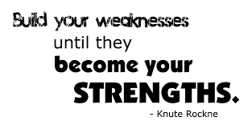
Weaknesses
What tasks do you usually avoid because you don't feel confident doing them?
What will the people around you see as your weaknesses?
Are you completely confident in your education and skills training? If not, where are you weakest?
What are your negative work habits (for example, are you often late, are you disorganized, do you have a short temper, or are you poor at handling stress)?
Do you have personality traits that hold you back in your field? For instance, if you must conduct meetings on a regular basis, a fear of public speaking would be a major weakness.
Notes:
Weaknesses:
Skills Gap:
Limited experience in [specific skill].
Need to improve proficiency in [specific tool].
Time Management:
Tendency to overcommit and struggle with time management.
Difficulty in saying 'no' to additional tasks.
Public Speaking:
Limited experience or confidence in public speaking.
Opportunity for improvement in presenting ideas effectively.

Slide 13

Opportunities
Are any of your peers failing to do something important? If so, can you take advantage of their mistakes?
Is there a need in your company or industry that no one is filling?
Do your colleagues complain about something in your work? If so, could you create an opportunity by offering a solution or taking advantage?
Notes:
Opportunities:
Market Trends:
Emerging trends in [Your Industry] align with my skills.
Opportunities for growth in [specific market segment].
Networking:
Potential collaborations with professionals met through networking events.
Opportunities for mentorship and learning from industry leaders.
Professional Development:
Possibility for further education or certifications.
Opportunities to attend conferences or workshops.

Slide 14

Threats
What obstacles do you currently face at Work/College?
Are any of your colleagues/students competing with you for projects or roles?
Is your job (or the demand for the things you do) changing?
Does changing technology threaten your position?
Could any of your weaknesses lead to threats?
Notes:
Threats:
Industry Competition:
Increasing competition in [Your Industry].
Need to stay updated on industry advancements.
Economic Factors:
Economic downturn affecting job stability.
Budget constraints impacting professional development opportunities.
Technology Changes:
Rapid technological changes affecting current skill relevance.
Need to adapt to new tools and technologies.

Slide 15
Task
For next week, I want you to write a SWOT Analysis for yourself.
We will discuss these in class.
You will act as managers of a business to help, support and provide feedback to each other. This will help form groups for presentations.
Blank SWOT Analysis sheet can be found in the Files section of Career Skills Channel.

Slide 16
Questions?/Next Week
SWOT Analysis to complete and discuss.
SMART Goals and setting Aims for yourself.
Presentation Groups/Topics
Types of Communication/How to improve presenting skills.

